Slide 1
Project: Sign Language Recognition
Team Members:-
Jasroop Singh (18BCE10125)
Pratyush Sethi (18BCE10345)
Hershil Piplani (18BCE10112)
Guide:-
Dr.Shubham Gupta
Supported By:-
Dr.Praveen Lalwani

Slide 2
Objective/Problem Statement
The main objective of our project is to make the communication possible between the speech and hearing impaired people and the masses. As not all of people know sign language so to make them converse with dumb and deaf people without knowing sign language.

Slide 3
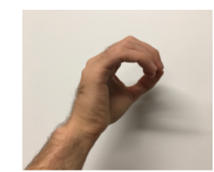
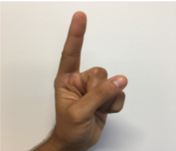

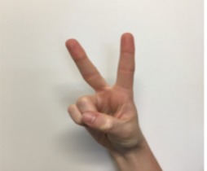
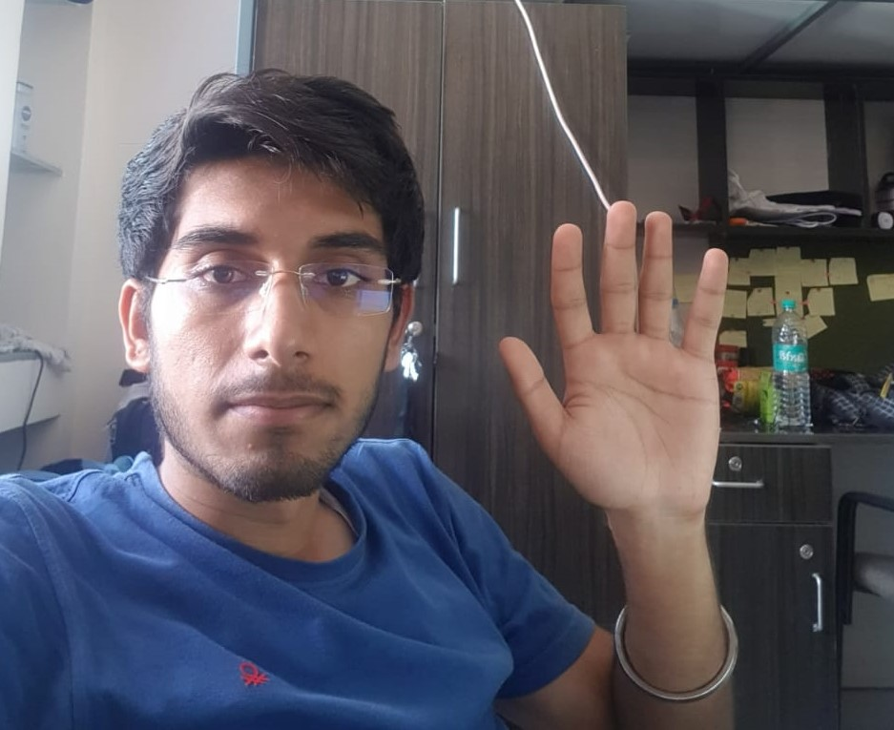
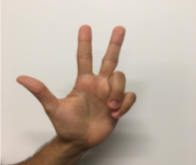
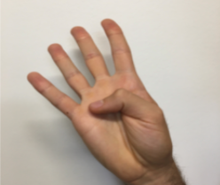
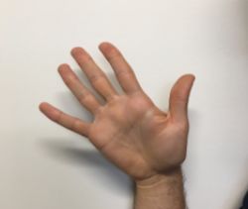
Architecture Diagram
Storing Image Frames
Feature Extraction
Feature Extraction
Neural Network
Prediction

Slide 4
Flow Diagram
Train Time
Test Time
Dataset
webcam
Getting Image Frames
Feature Extraction (all images in dataset)
Feature Extraction
Neural NETWORK
Neural NETWORK
Checking with the output labels
TRUE
If < epochs
Prediction
FALSE
Trained Neural Network

Slide 5
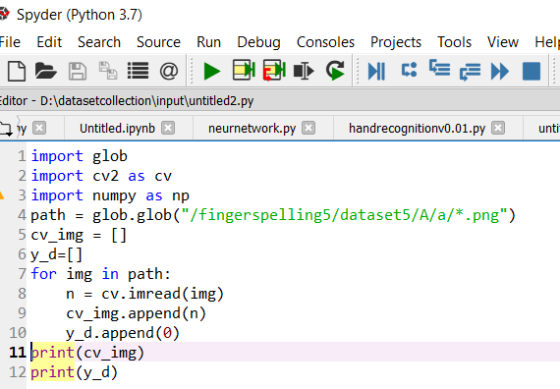
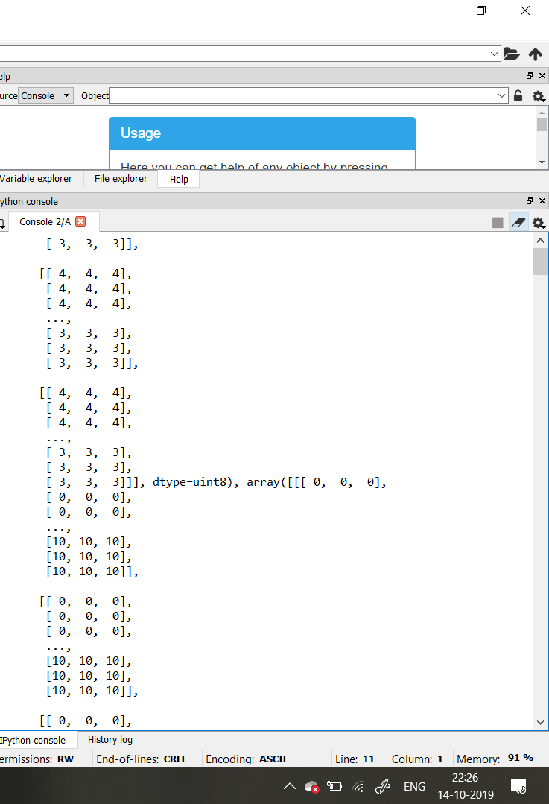
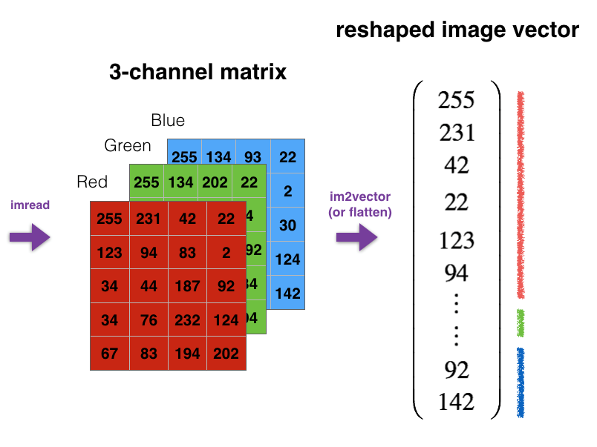

Feature Extraction
From Dataset
Tools Used:- OpenCV, H5py,etc.
We use the above mentioned libraries to read image in vector ,
then we concatenate for all images in dataset.
Dataset citation:- From Kaggle by Alex

Slide 6
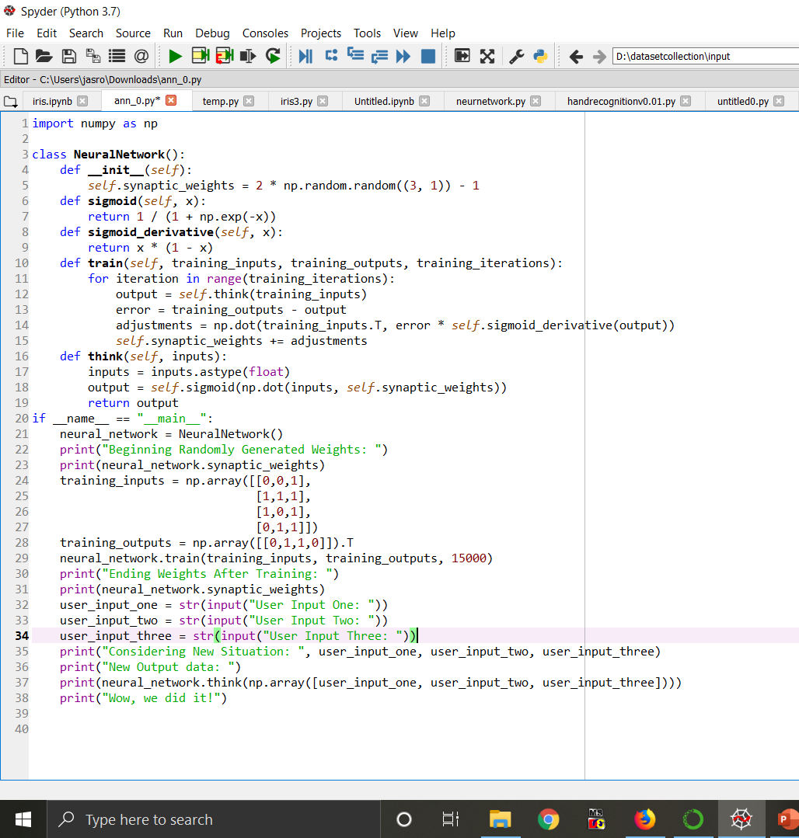
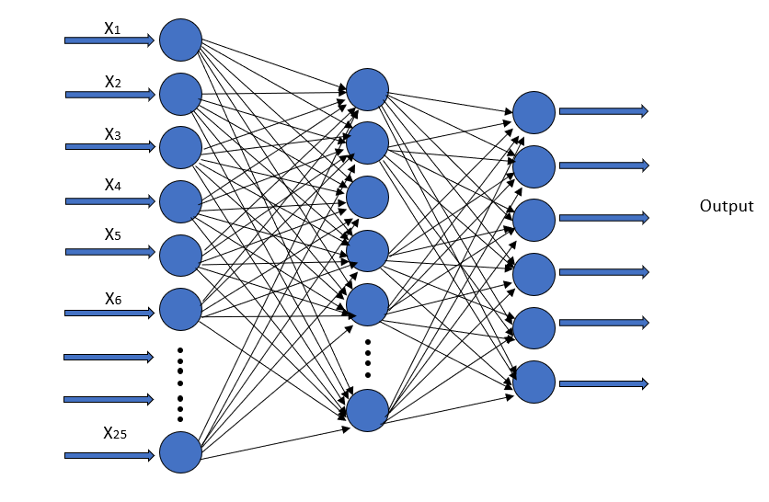



Neural Network
The feature vector is now fe in the neural network, after that computation ,occurs. It occurs in two steps firstly forward prop is done then backprop is to be computed on the basis of the backprop values or weights(parameters) of neural network are updated for prediction. This is known as training of neural network.
Tools Used:- numpy,scipy,etc..

Slide 7
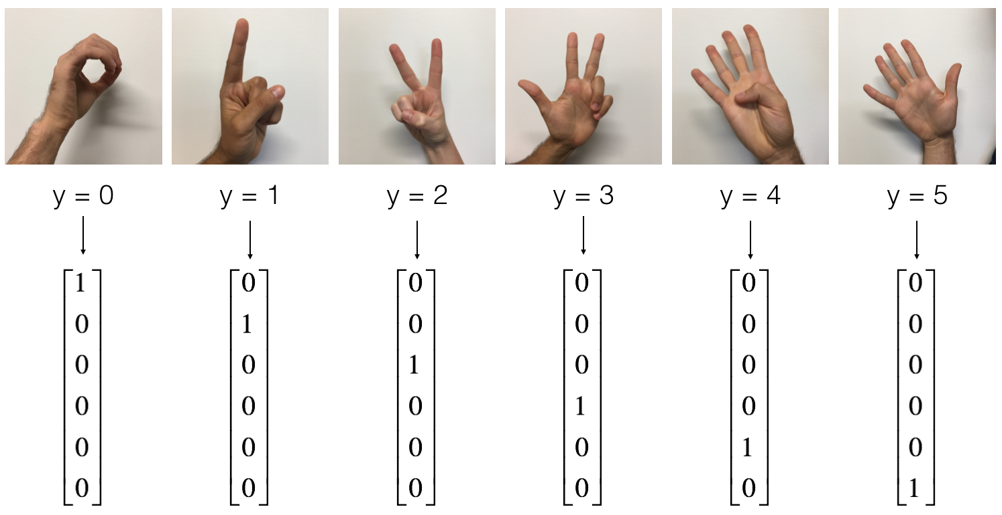
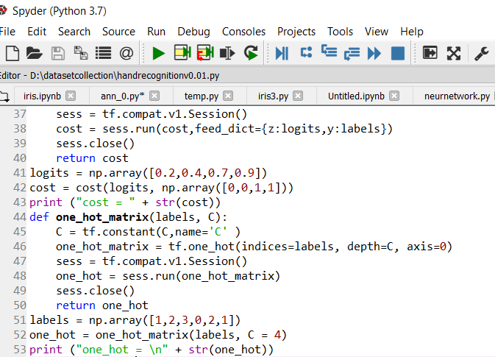
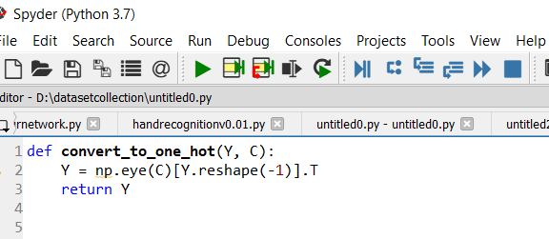
Prediction
Now , we get the output of neural network then we use softmax regression or classifier to get our final output by one hot encoding. On the basis of values we get to know what type of gesture it is. Ex- if y=1 then its 1,etc.. So we have numbers distributed for type categories

Slide 8
ON RUN TIME
CAPTURING ROI(REGION OF IMPORTANCE)
RESIZING CAPTURED ROI INTO 64 BY 64 FOR FEEDING INTO TNN.
Trained Neural Network
300x300
OUTPUT:

Slide 9
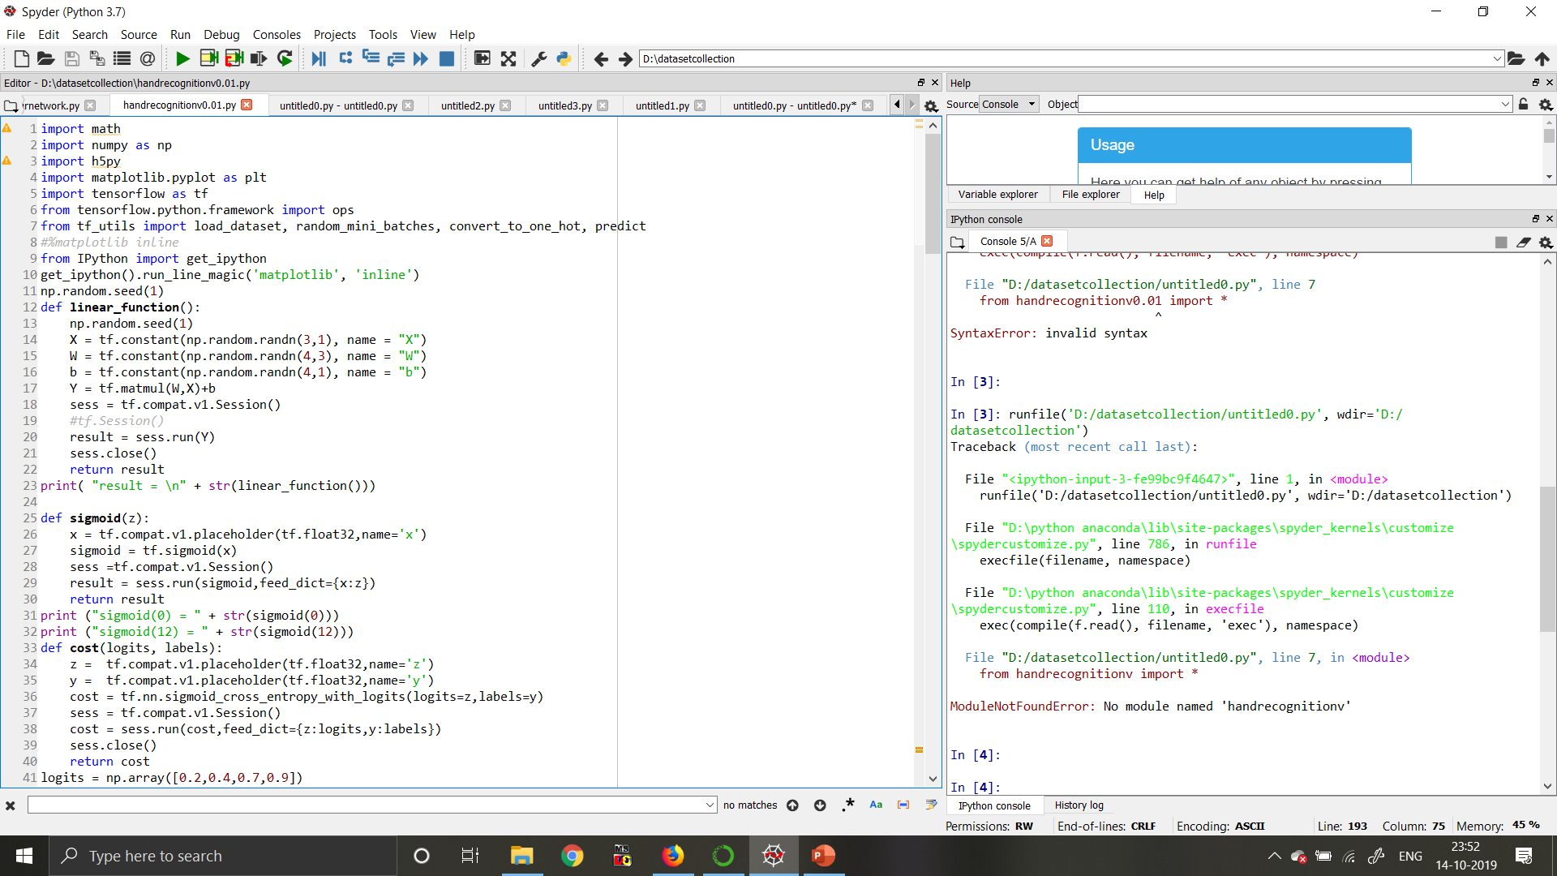
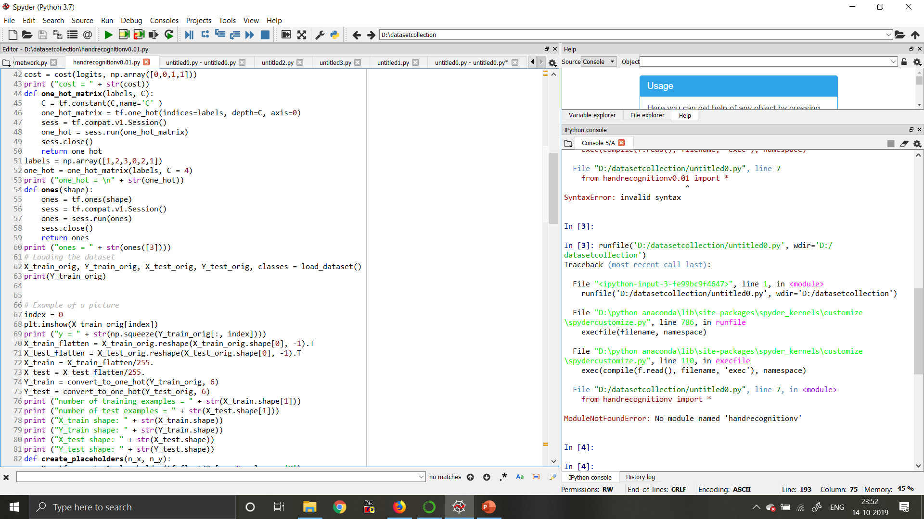
Implementation

Slide 10
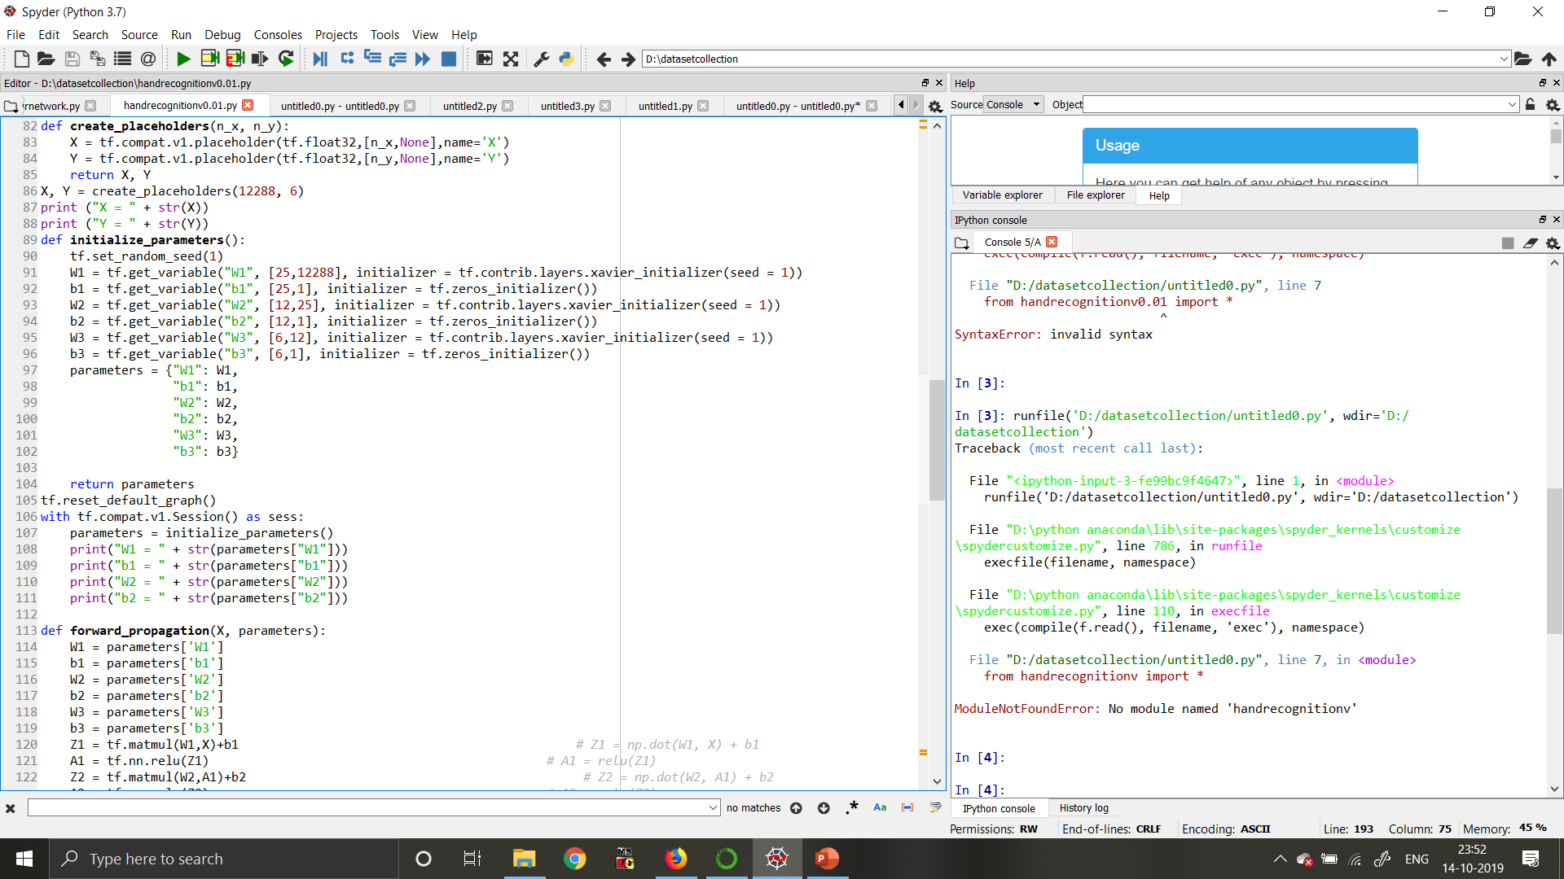
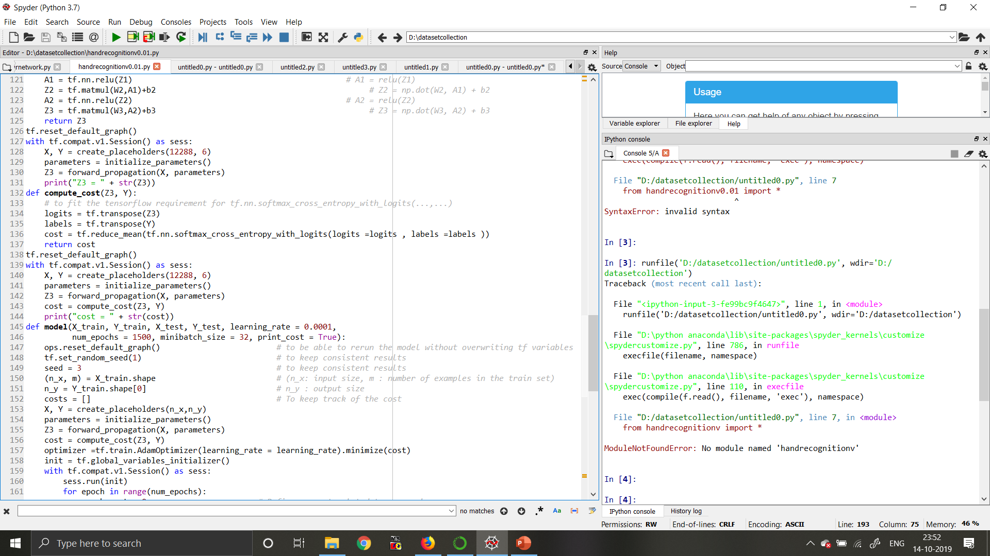

Slide 11
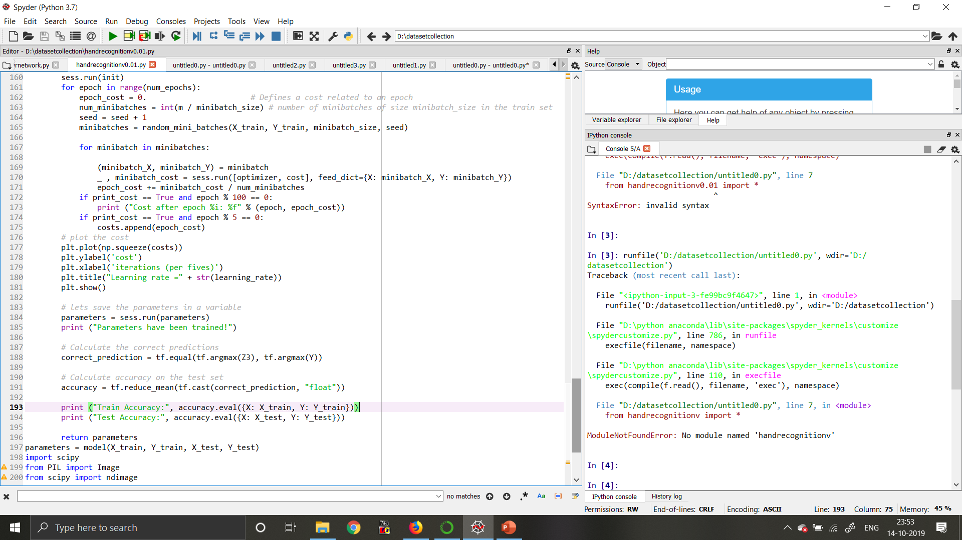
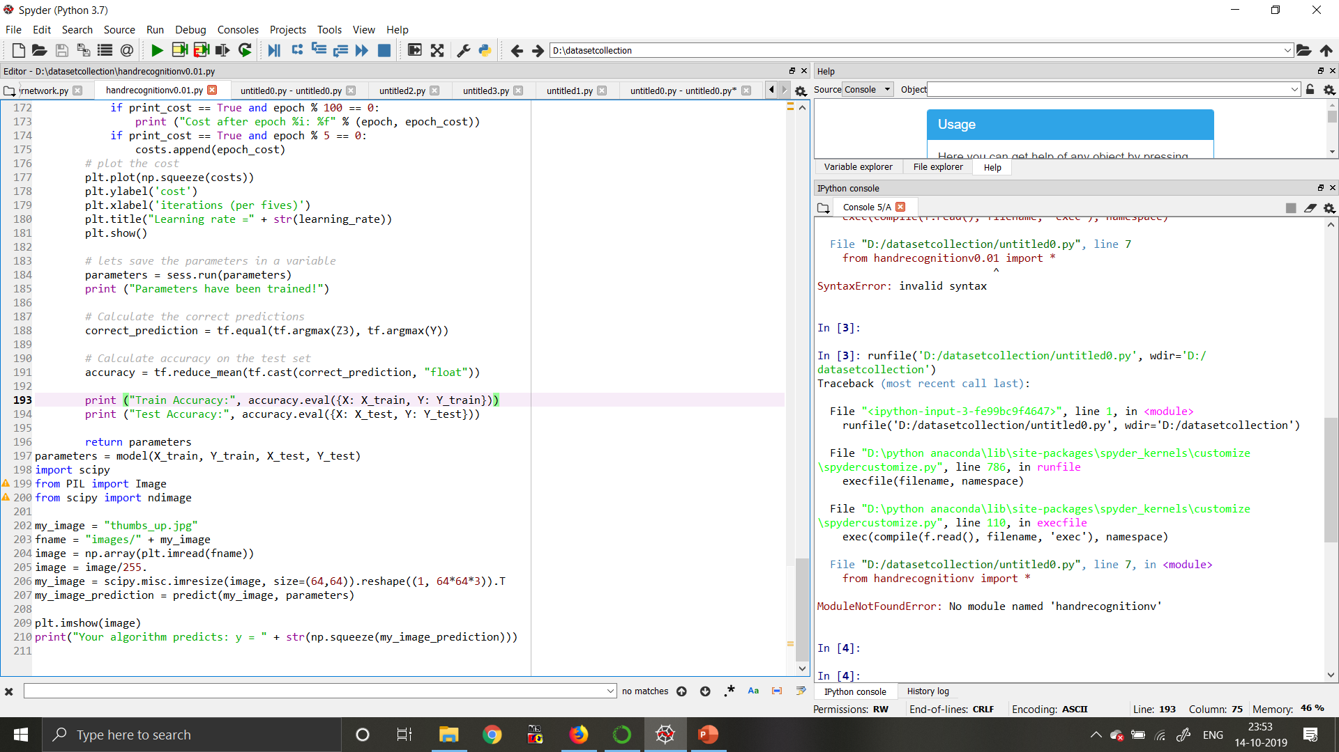

Slide 12
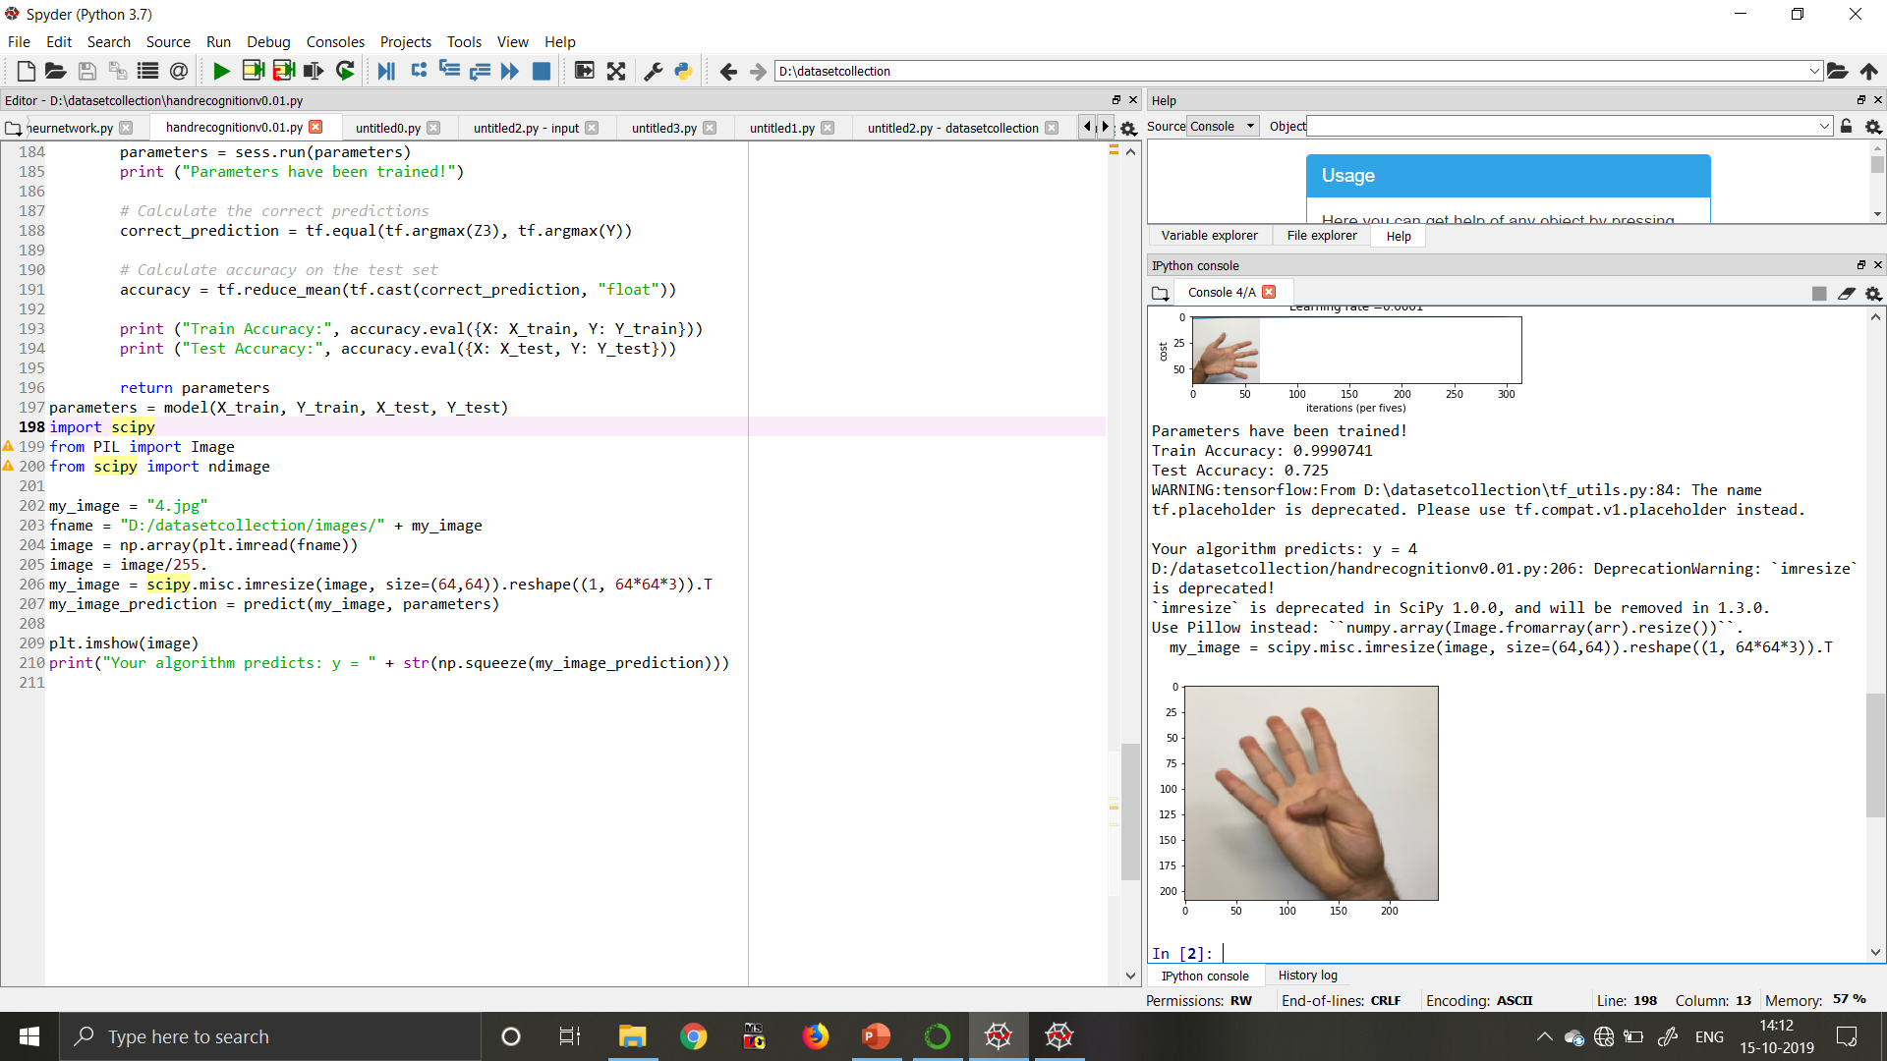
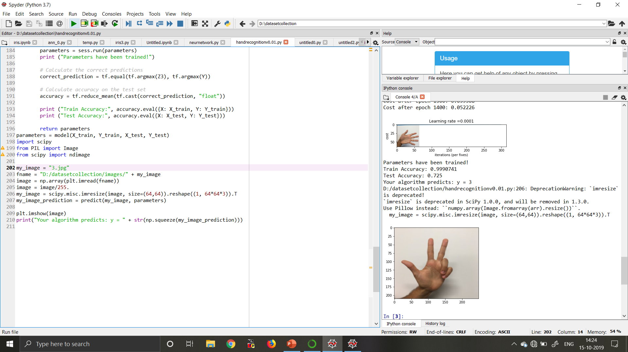
Output

Slide 13
References
Deep Learning(book) by Ian Godfellow
Online websites:-
Machinelearningguru.com
Documentations of respective python libraries, etc.

